Slide 1
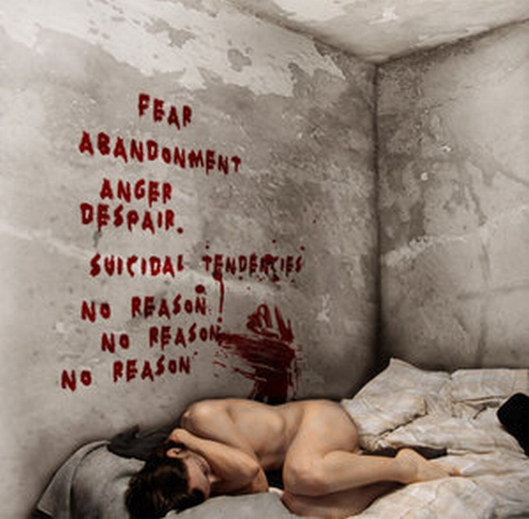
BoRdErLiNe
PERSONALITY DISORDER
i HATE you…
DON’T LEAVE ME

Slide 2
University of Washington psychologist Marsha Linehan, one of the world's leading experts on BPD, describes it this way: "Borderline individuals are the psychological equivalent of third-degree-burn patients. They simply have, so to speak, no emotional skin. Even the slightest touch or movement can create immense [emotional] suffering.”

Slide 3
Must Present 5 of 9 Symptoms for Diagnosis
1. Use extreme measures to avoid real or imagined abandonment.
2. Intense and unstable relationships with others that can frequently alternate between admiration and depreciation
3. Identity issues with an unstable sense of self-esteem
4. Impulsivity in two potentially harmful areas
5. Suicidal behavior, gestures, or threats
6. Self-mutilating behavior
7. Persistent feelings of emptiness
8. Inappropriate or hard to control anger
9. Short-lasting or stress-evoked paranoia or severe dissociation

Slide 4

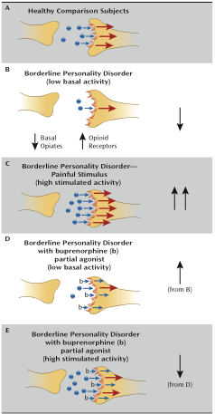
We propose a model of reduced basal opioid activity in critical limbic circuitry, including the cingulate cortex and the amygdala, in individuals with borderline personality disorder. Basal opioid levels in borderline personality disorder are hypothesized to be reduced in output, while receptors are increased in number, so that during unstimulated conditions, borderline patients experience dysphoria associated with reduced tonic opioid activity. When stress or pain causes an increase in release of opioids, there is an increased opioid signal and relief from dysphoria. Treatment with buprenorphine, a partial agonist, would increase basal opioid signal under baseline conditions of low tonic activity and antagonize opioid receptors under conditions of increased output (e.g., self-injurious behavior).

Slide 5
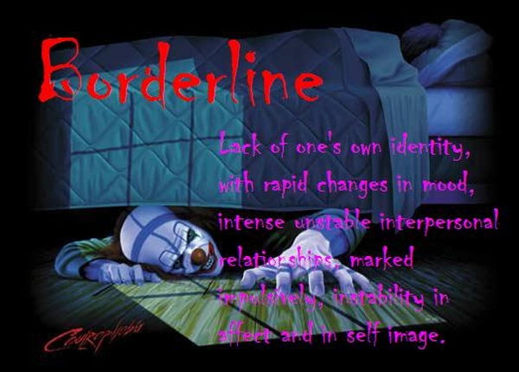
Borderline patients seem to have no internal governor; they are capable of deep love and profound rage almost simultaneously. They are powerfully connected to the people close to them and terrified by the possibility of losing them — yet attack those people so unexpectedly that they often ensure the very abandonment they fear. When they want to hold, they claw instead…

Slide 6
